Slide 1

Digitaler Wandel und Europäische Kompetenzagenda
Alexander Riedl
Digitale Wirtschaft und Kompetenzen
DG Connect
Europäische Kommission
Workshop - 22 September 2017
@DigitalSkillsEU #DigitalSkills #DSJCoalition

Slide 2
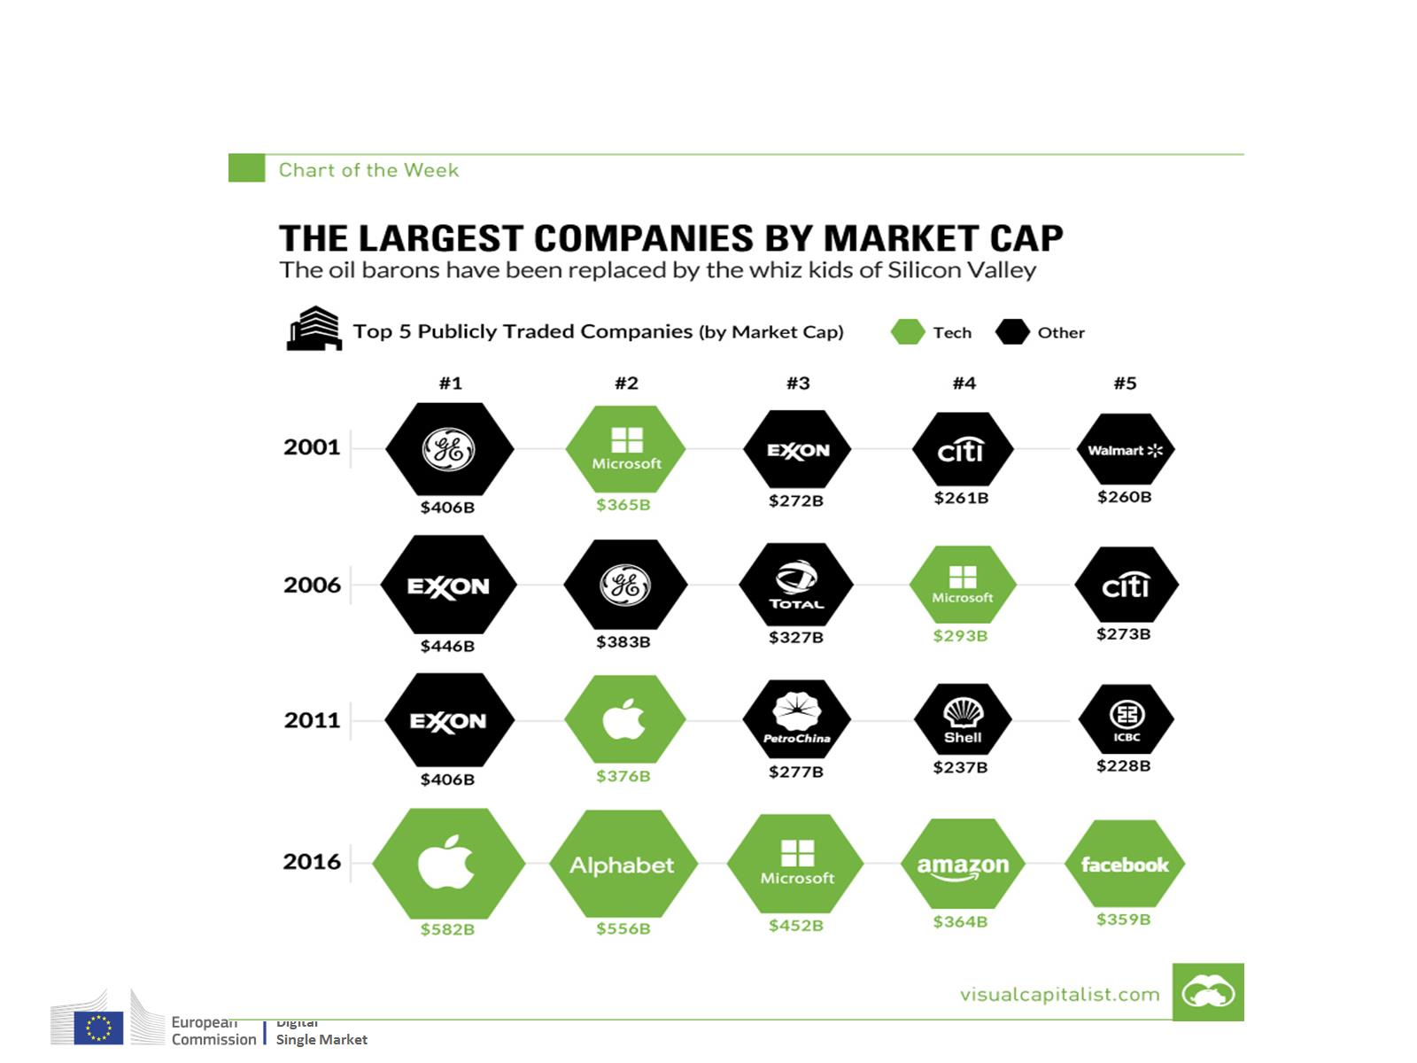

Slide 3
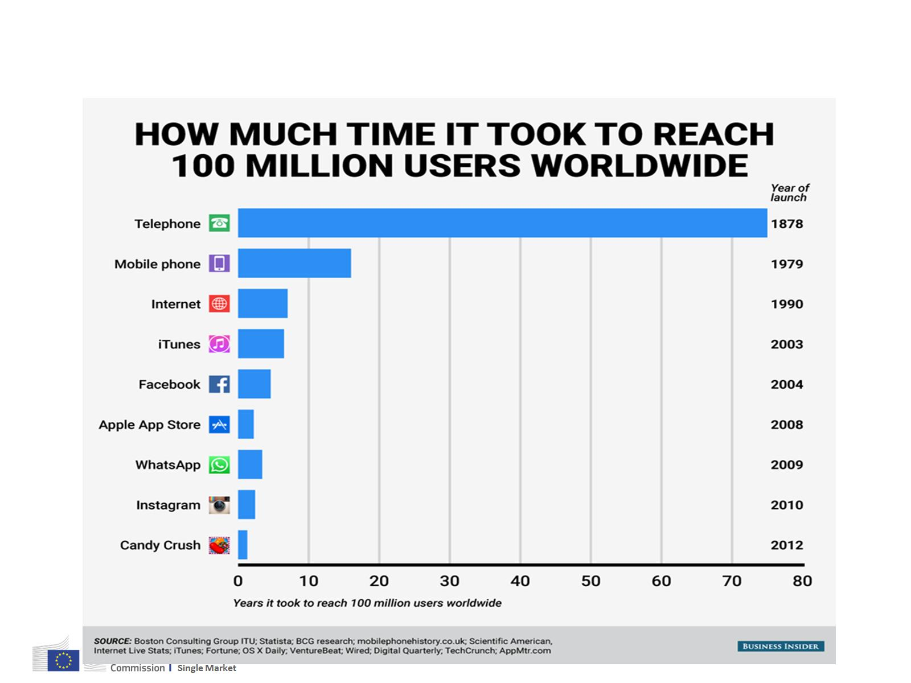

Slide 4


Slide 5


Slide 6


Slide 7
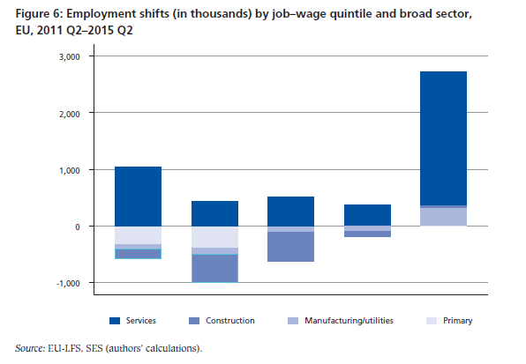
Polarisierung auf dem Arbeitsmarkt
Source: Eurofund Jobs Monitor 2016

Slide 8
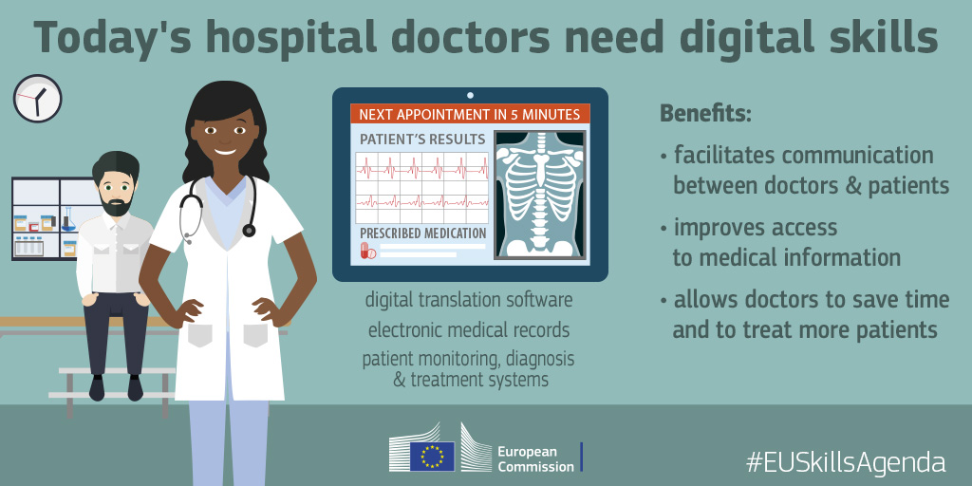
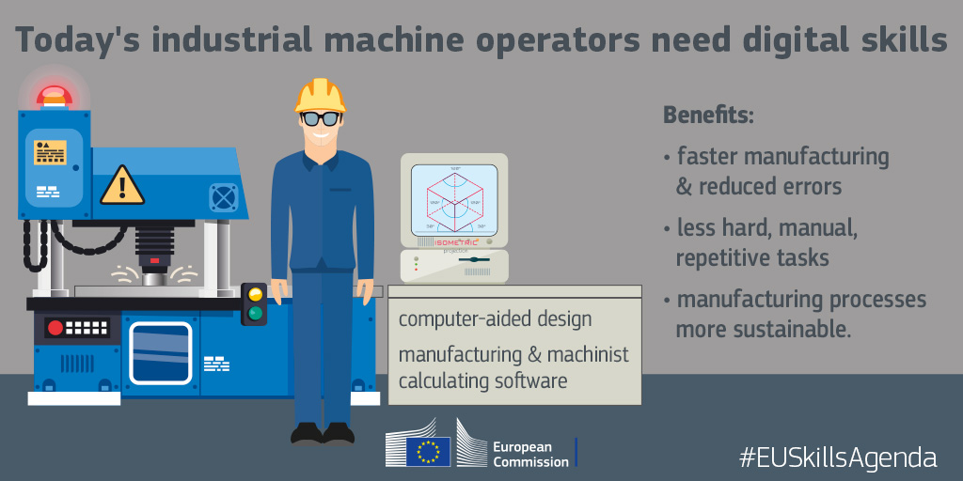

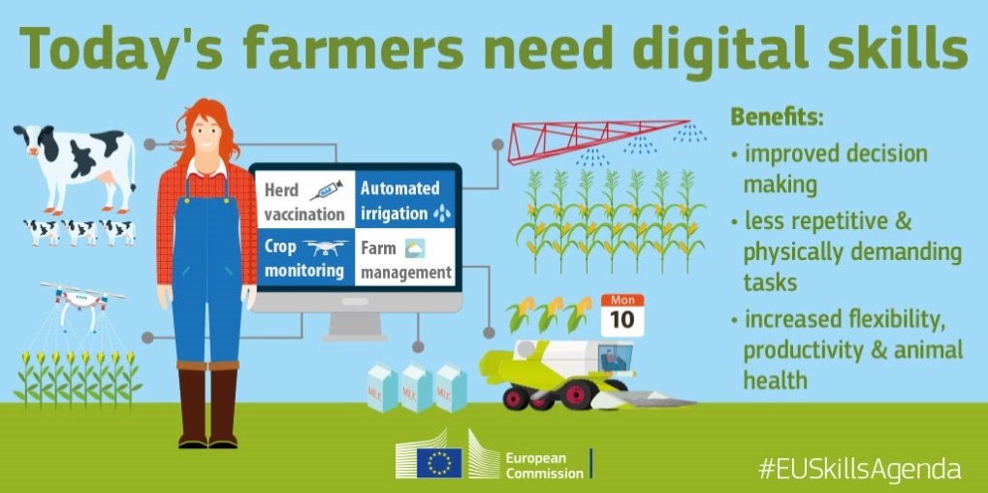
Der digitale Wandel betrifft alle Sektoren

Slide 9
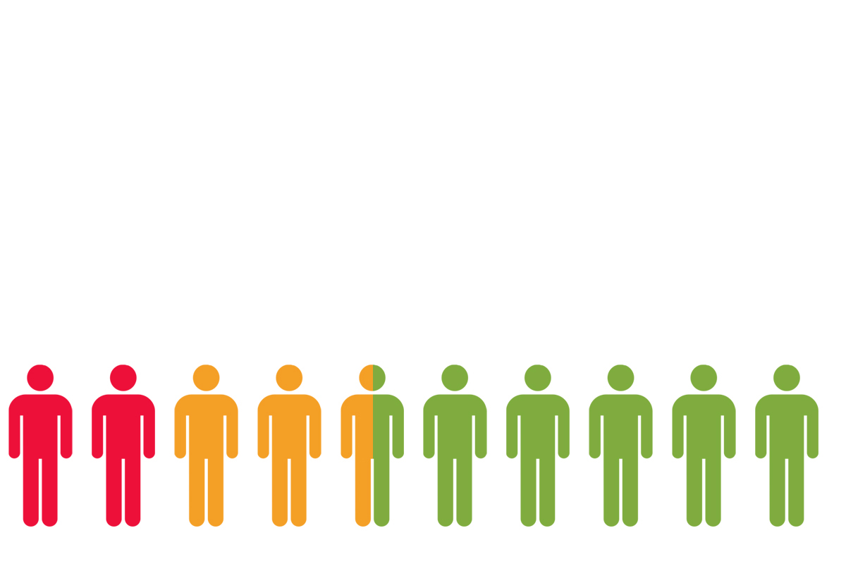
Digitale Kompetenzen der europäischen Bürger
43%
57%
Source: DESI 2017

Slide 10


Digitale Kompetenzen der Erwerbstätigen
37% in der EU haben keine Basiskenntnisse
ICT jobs = 3.7% der Totalbeschäftigung
Mehr als 600,000 offene Stellen für IKT-Spezialisten
40% der Unternehmen, die IKT-Spezialisten einstellen möchten, haben Probleme geeignete Kandidaten zu finden

Slide 11
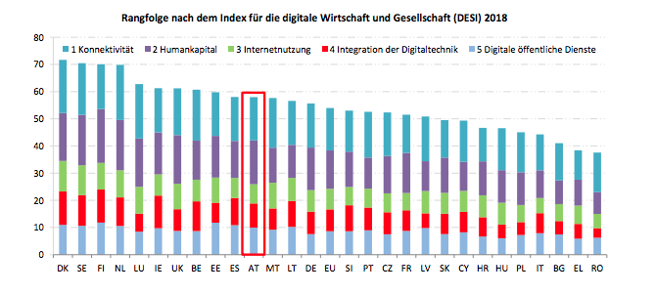
Österreich im DESI (Digital Economy and Society Index)

Slide 12
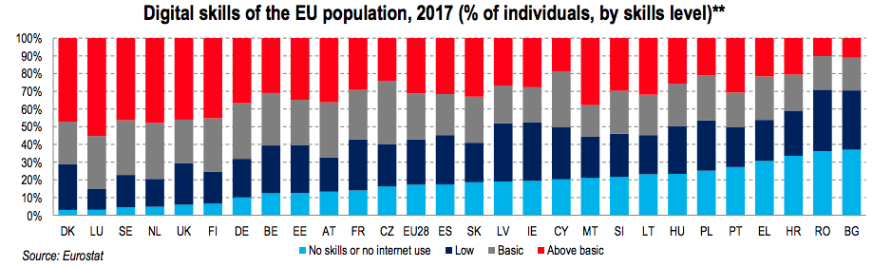
… und bei den digitalen Kompetenzen

Slide 13
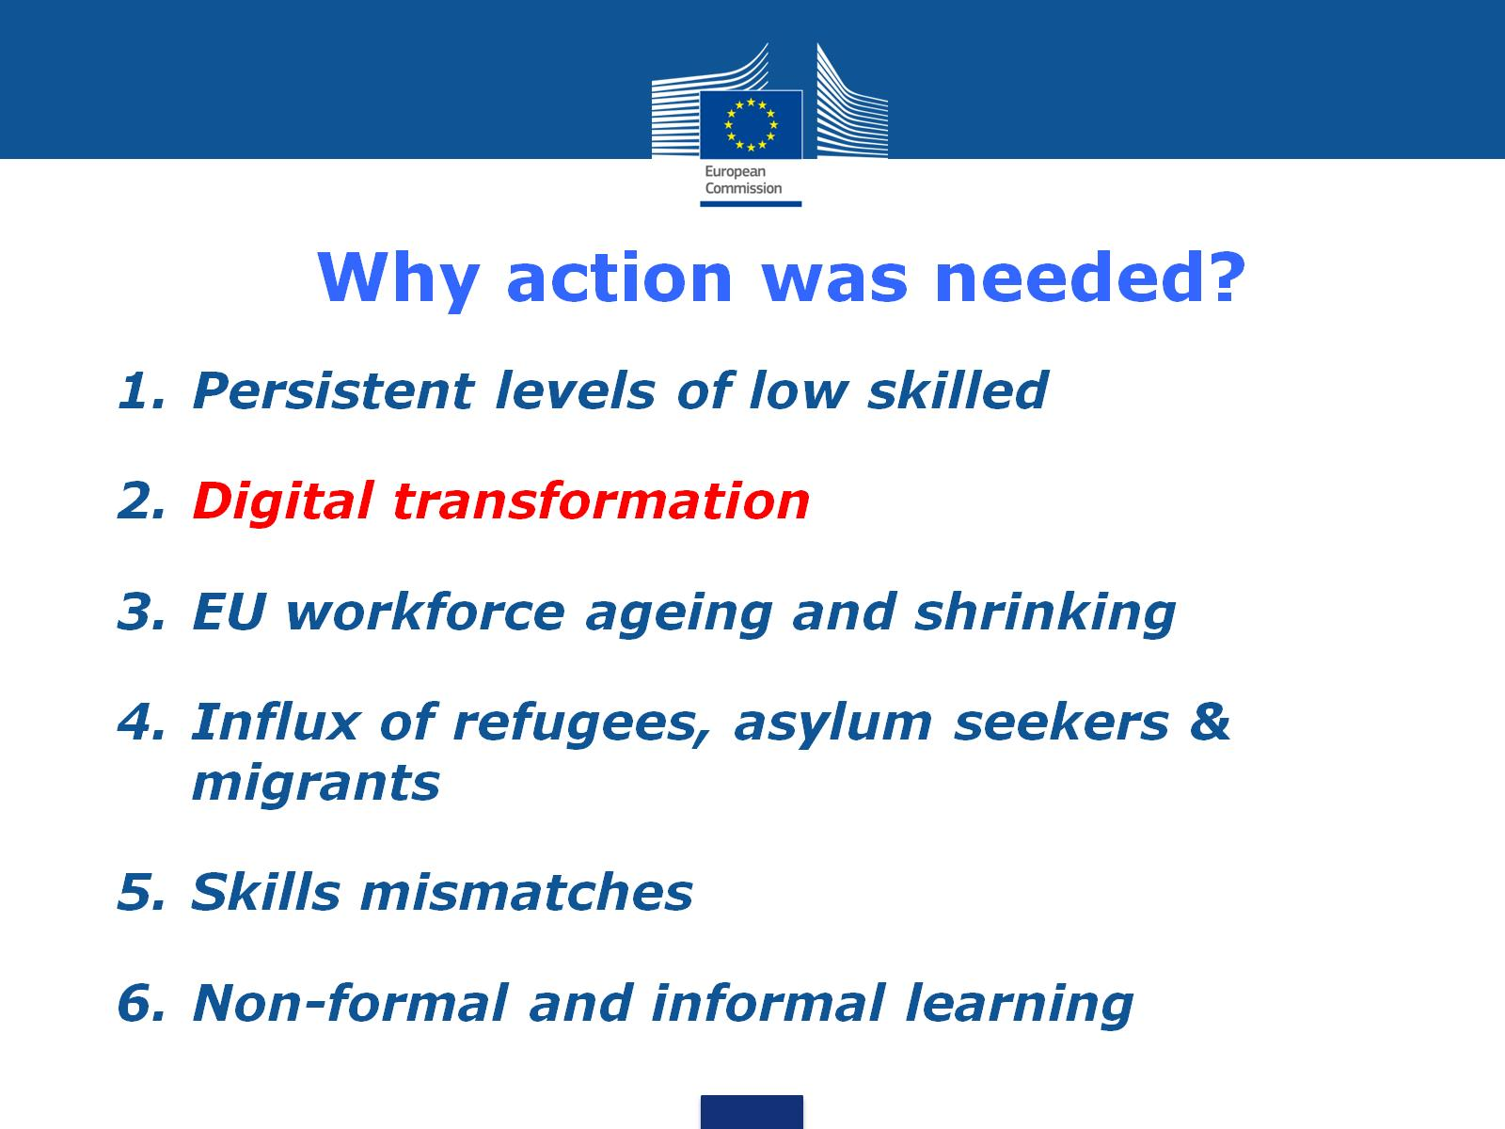
Why action was needed?

Slide 14
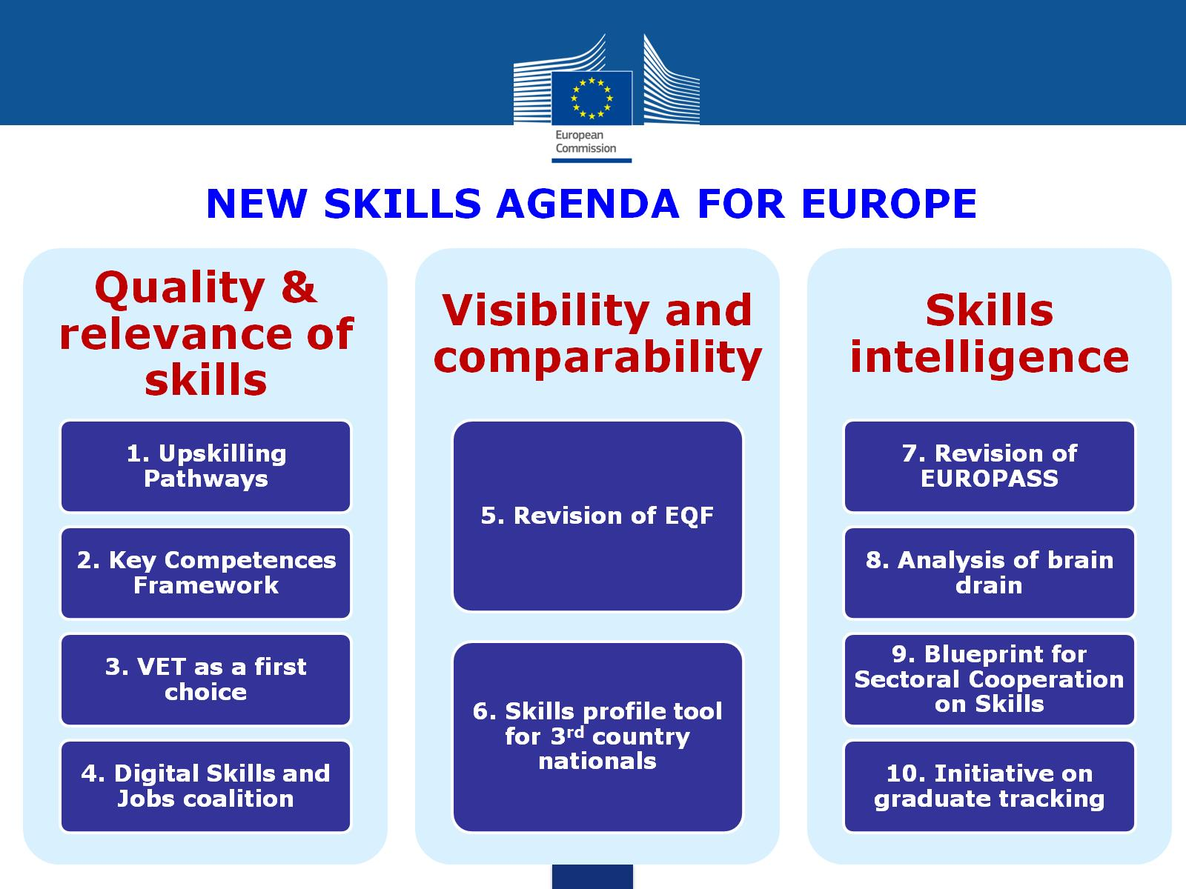

Slide 15
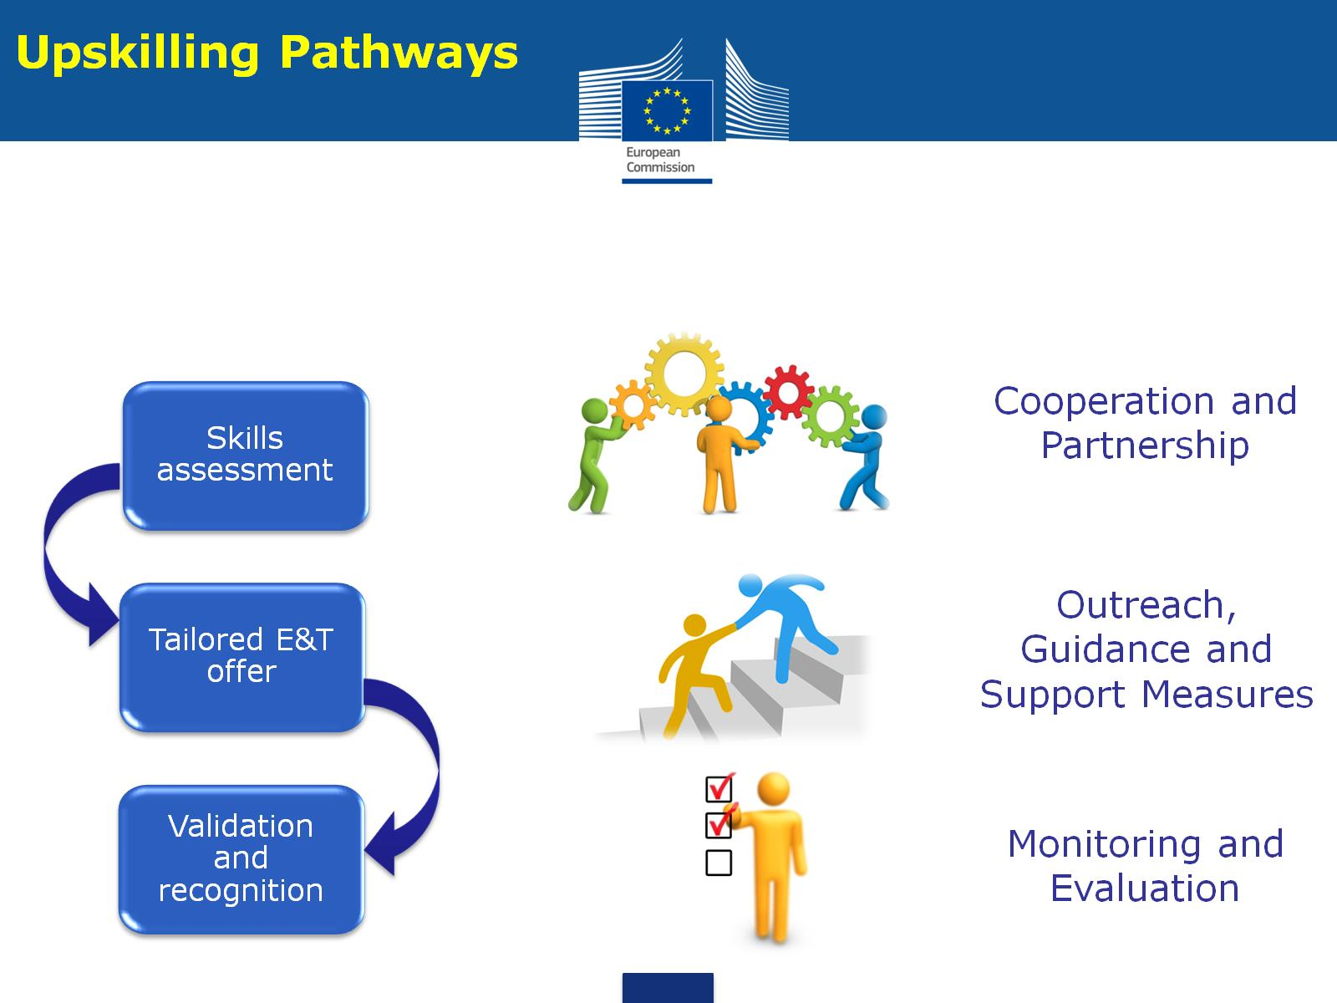

Slide 16
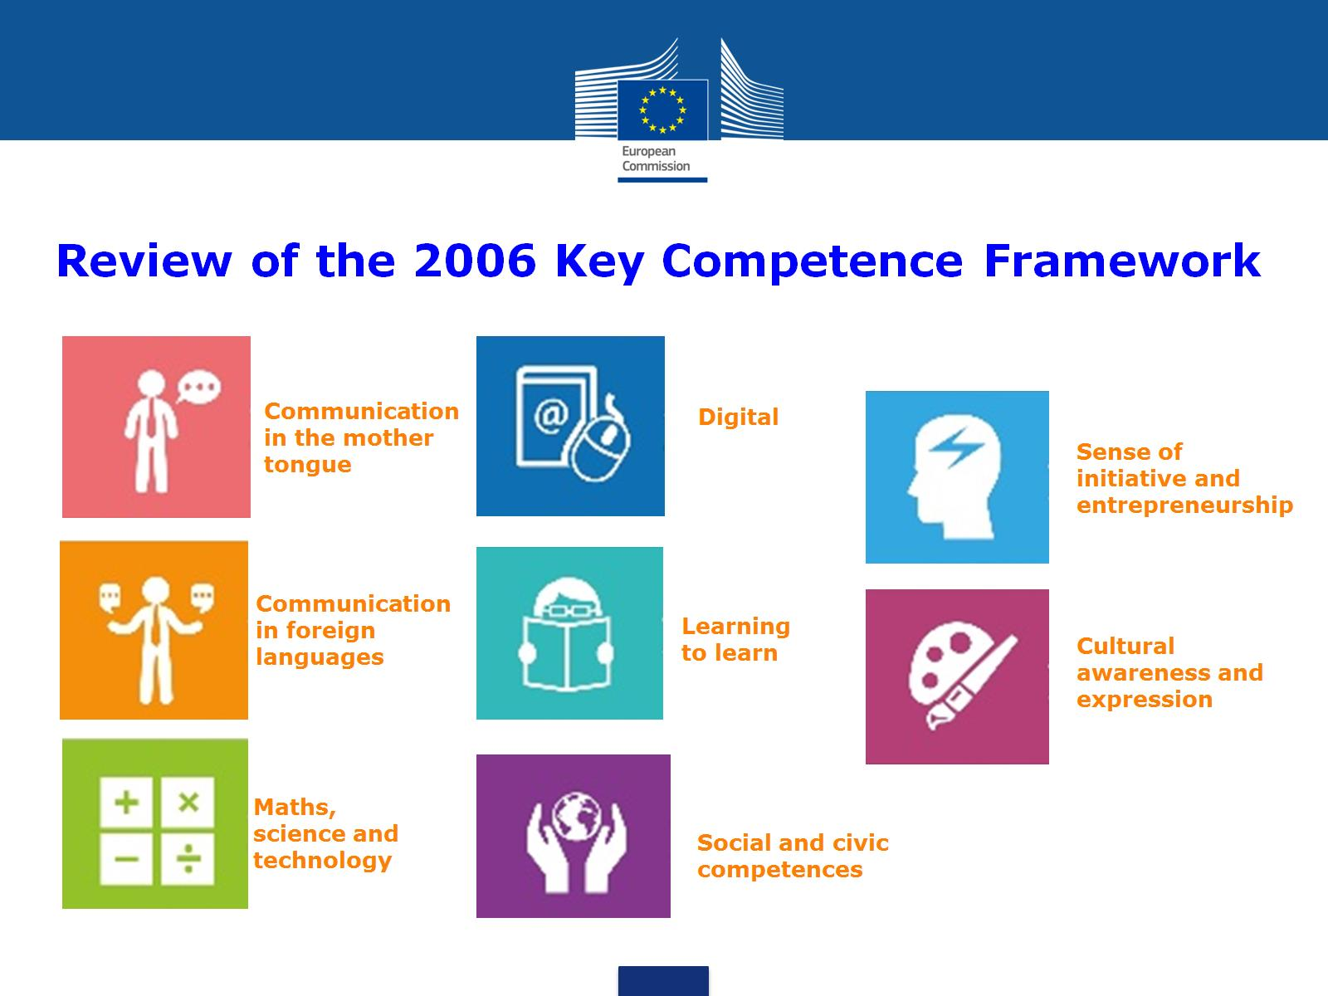

Slide 17


Slide 18
Role of the EU
Propose solutions and initiate stakeholder partnerships to encourage all citizens and the workforce of all sectors to reskill and upskill
Involve Member States in designing and delivering solutions
Best-practice exchange
Better use of European and national funds also through the support of pilot projects

Slide 19
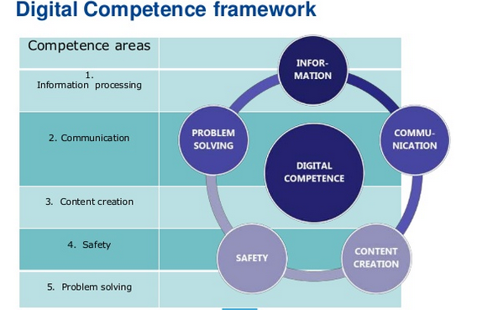

Slide 20





Digital Skills and Jobs Coalition
1 of 10 actions in New Skills Agenda for Europe
Multi-stakeholder partnership
Take action to tackle the lack of digital skills in Europe for four target areas.
ICT professionals
Education
Labour force
Citizens

Slide 21
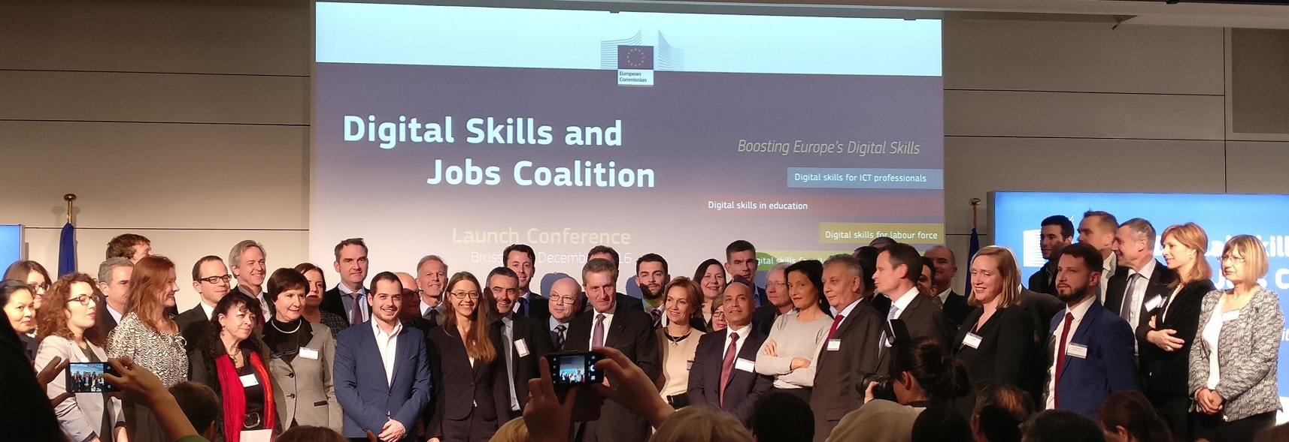
Where are we?
More than 400 Members
More than 100 “pledges”, concrete commitments to do something about digital skills
23 National Coalitions

Slide 22


A pilot project to provide cross-border traineeships
for up to 6,000 students and recent graduates
from all disciplines in 2018-2020
Website: bit.ly/DigitalOpportunities

Slide 23


Slide 24


Slide 25
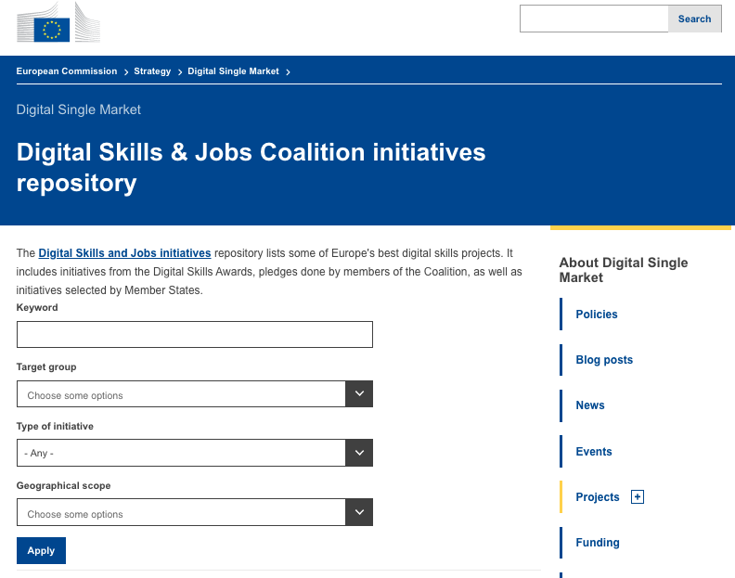

Slide 26
Vielen Dank!
alexander.riedl@ec.europa.eu
@DigitalskillsEU

