Slide 1

Gender Equality at work in the context of EU Funds
Helena Morais Maceira
Vienna, 5 December 2019

Slide 2

Gender Equality is a fundamental value
of the EU and is vital to its socio-economic growth

Slide 3
Gender Equality Index 2019

Slide 4
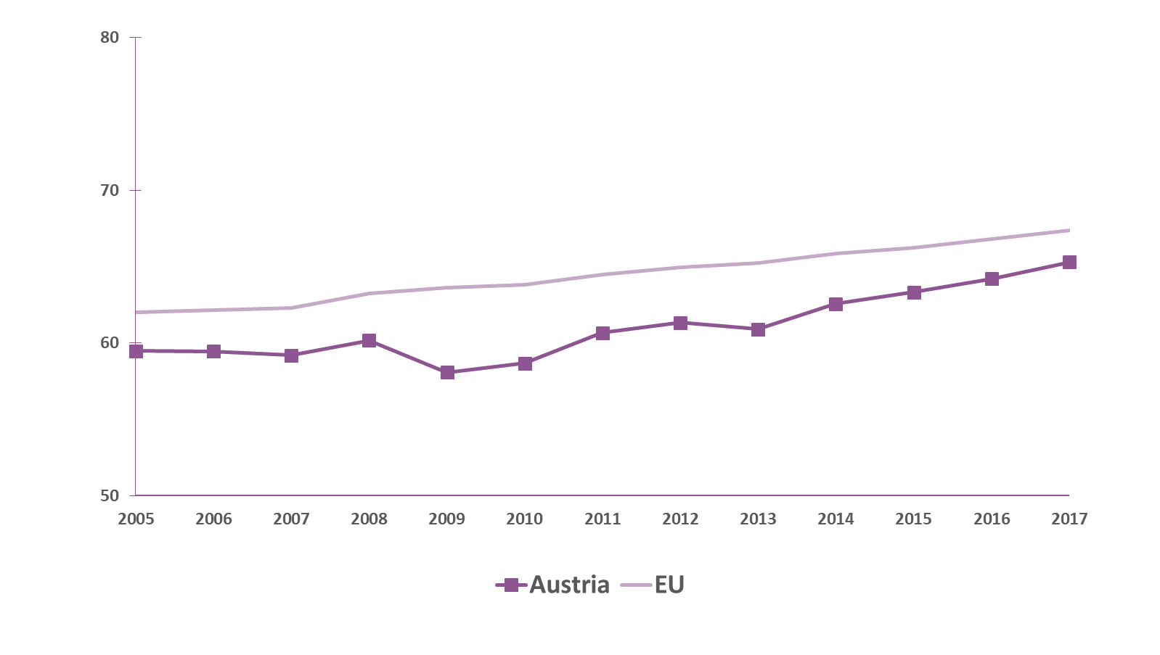
Austria and the EU average are advancing in the same direction

Slide 5
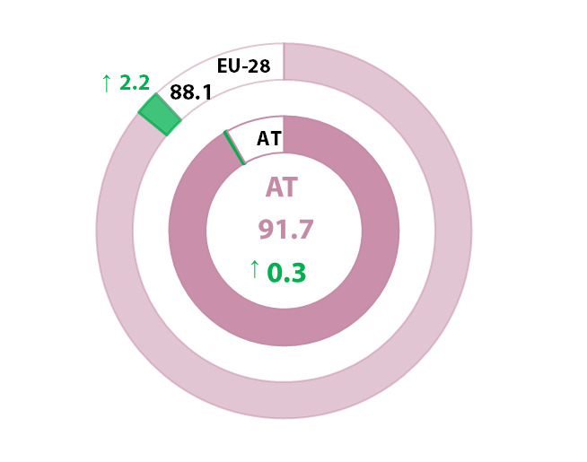
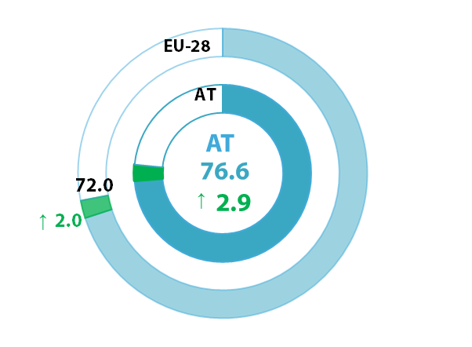
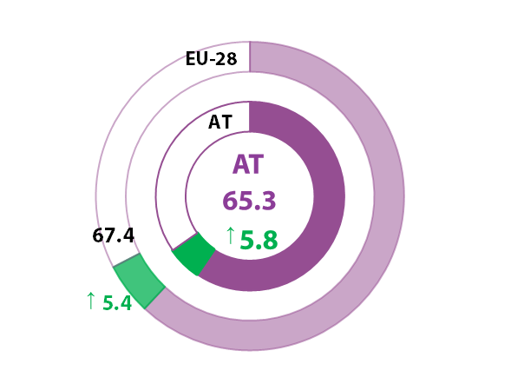
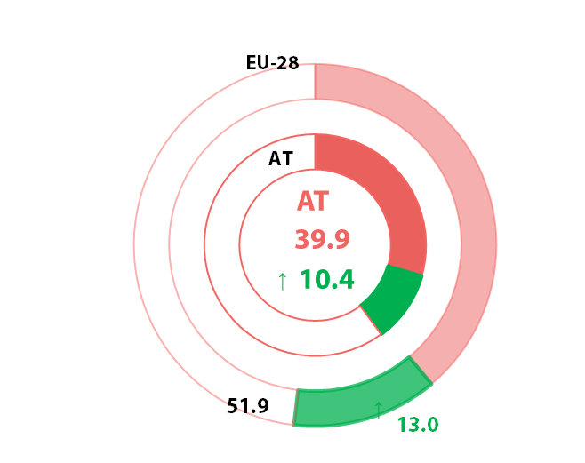
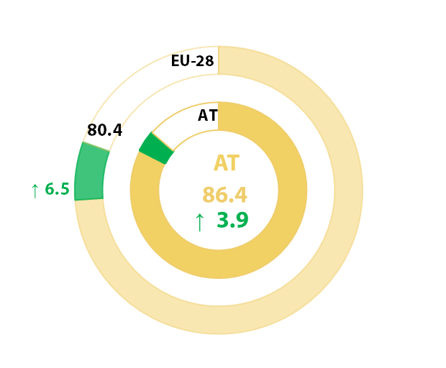
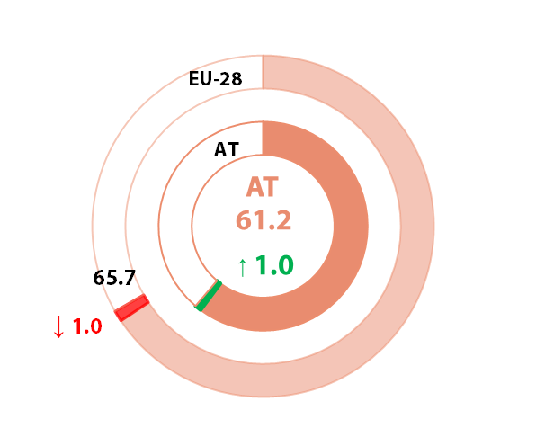
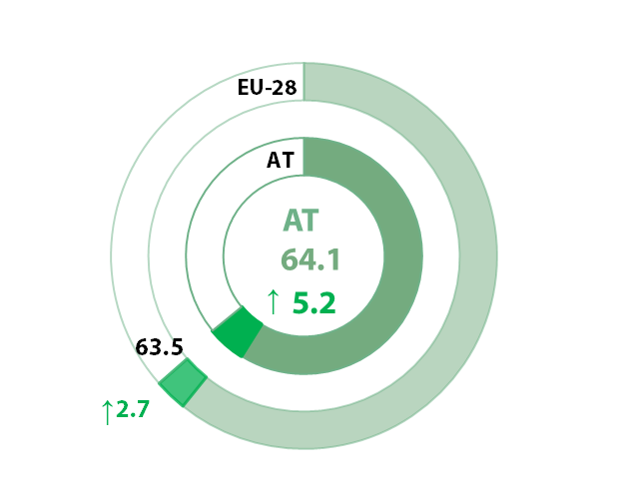
WORK
6 → 5
HEALTH
3 → 4
13 = 13
MONEY
5 → 8
POWER
18 → 17
TIME
15 → 16
KNOWLEDGE
11 → 11
Inequality
1
Increase 2005 - 2017
Decrease 2005 - 2017
Equality
100

Slide 6
Gender pay gap and gender overall earnings gap: wider inequalities in labour market reflected

Slide 7


Dual approach
Gender
mainstreaming
&
Specific
Actions

Slide 8
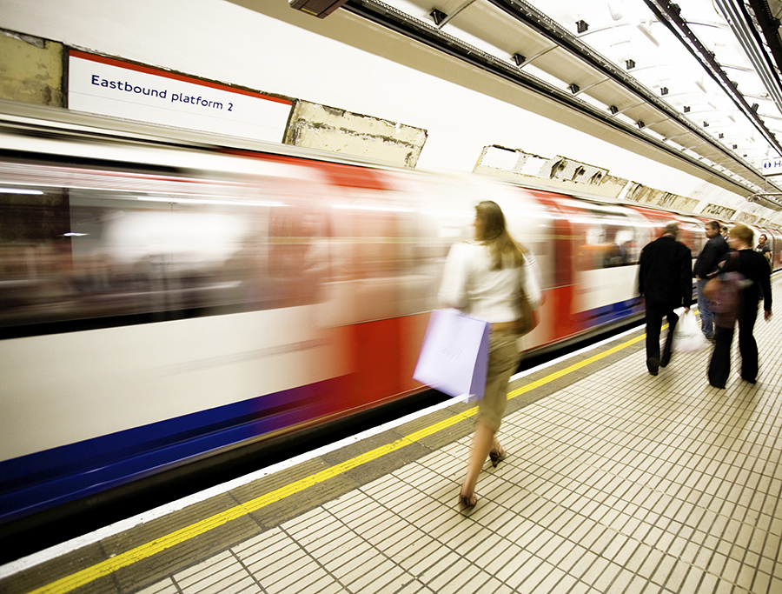
Transport and infrastructure
Different needs and perceptions
Safety considerations for women
Segregation in the labour market and decision making

Slide 9



The state of play: gender equality in ESIF programmes
Gender mainstreaming and gender equality objectives in “horizontal themes”
with NO impact on the content
Gender-specific targets and indicators are missing

Slide 10
Toolkit for gender mainstreaming / budgeting in EU Funds 2021-2027
National/regional programming (and project level)
EU regulatory framework
Reporting, monitoring and evaluation
Tool 3.1 Integrating gender
perspectives in M&E processes
Tool 2.2 Gender equality aspects of policy
objectives (PAs) & measures (OPs)
Tool 2.1 Assessment of
gender inequalities and needs
Tool 3.2 Reporting on resource
spending for gender equality in ESIF
Tool 2.3 Coordination between the Funds to
advance work – life balance
Tool 2.4 Partnership and multi-level governance
Tool 2.5 Performance framework for
advancing gender equality
Tool 1. ESIF regulatory
framework considering
gender equality
Tool 2.6 Project selection – gender sensitive
selection criteria
Tool 2.7 Tracking resource allocation for
gender equality in ESIF
Tool 2.8 Mainstreaming gender equality
in project design

Slide 11
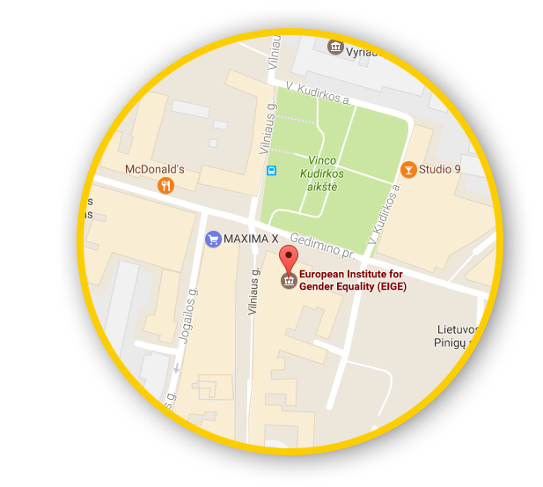





Let’s talk
Connect with us!
eige.europa.eu
facebook.com/
eige.europa.eu
twitter.com/
eurogender
come in for a chat!
youtube.com/
user/eurogender
Gedimino pr. 16,
LT-01103 Vilnius,
Lithuania
eige.europa.eu/
newsletter
eurogender.eige.
europa.eu

